Slide 1
Cystatin C and cardiovascular disease
An Example Mendelian Randomization study

Slide 2
The concept of Mendelian Randomization
Confounding factors
ApoE
Serum cholesterol
Cancer

Slide 3
The concept of Mendelian Randomization
Use genetic variants independent of any confounder
Include prospective studies to reduce reverse causation
Include deeply phenotyped studies to correct for potential confounders in the observational analysis

Slide 4
An example MR Study
Cystatin C and Cardiovascular Disease

Slide 5
Background
Cystatin C and Cardiovascular Disease

Slide 6
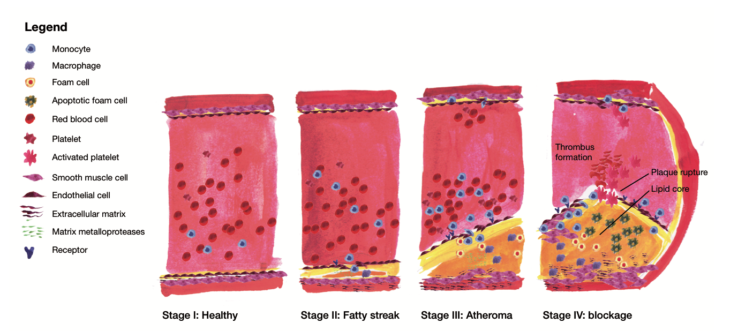
Atherosclerosis is the primary underlying cause of cardiovascular disease (CVD)
Van der Laan S.W. 2017. ISBN 978-90-393-6639-4

Slide 7
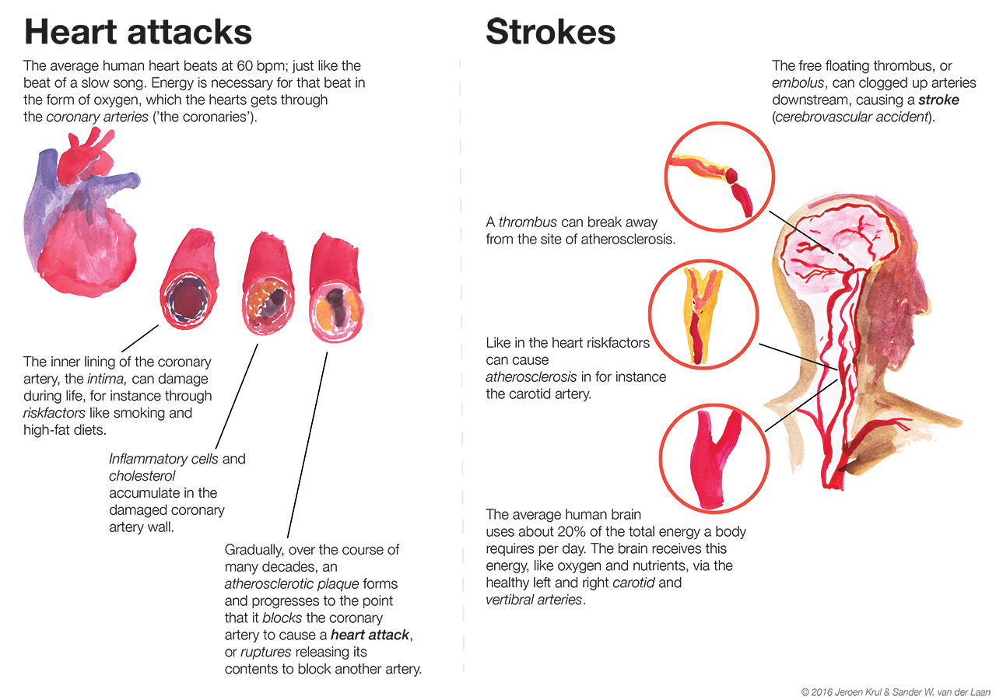
CVD: myocardial infarction (“heart attack”) or cerebrovascular accident (“stroke”)
Van der Laan S.W. 2017. ISBN 978-90-393-6639-4

Slide 8
Cystatin C (CystC)
Encoded by CST3 on 20p11.21
“Protease inhibitor”
It inhibits the activity of cathepsins (cysteine proteases) in vascular smooth muscle cells
Prevention of plaque formation by binding amyloid-beta precursor protein (APP) in Alzheimer’s disease
Shi et al. JCI 1999; Kaeser et al. Nat Genet 2007; Mi et al. Nat Genet 2007

Slide 9
A role in human and murine atherosclerosis
Reduction of CystC in abdominal aortic aneurysm (in smooth muscle cells)
Lack of CystC in ApoE^{-/-} mice promotes atherosclerosis
Shi et al. JCI 1999; Bengtsson et al. ATVB 2005

Slide 10
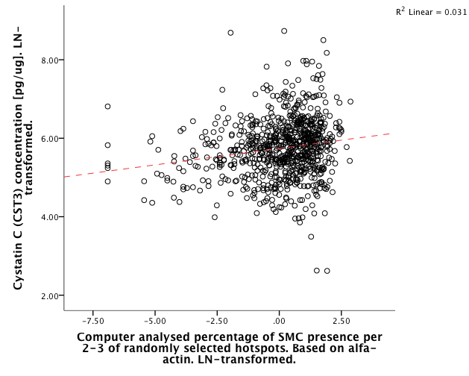
In carotid plaques CystC positively correlates with the percentage of smooth muscle cells
Rho = 0.185 (R = 0.176)
p = 1.10x10⁻⁷
Van der Laan et al. unpublished

Slide 11
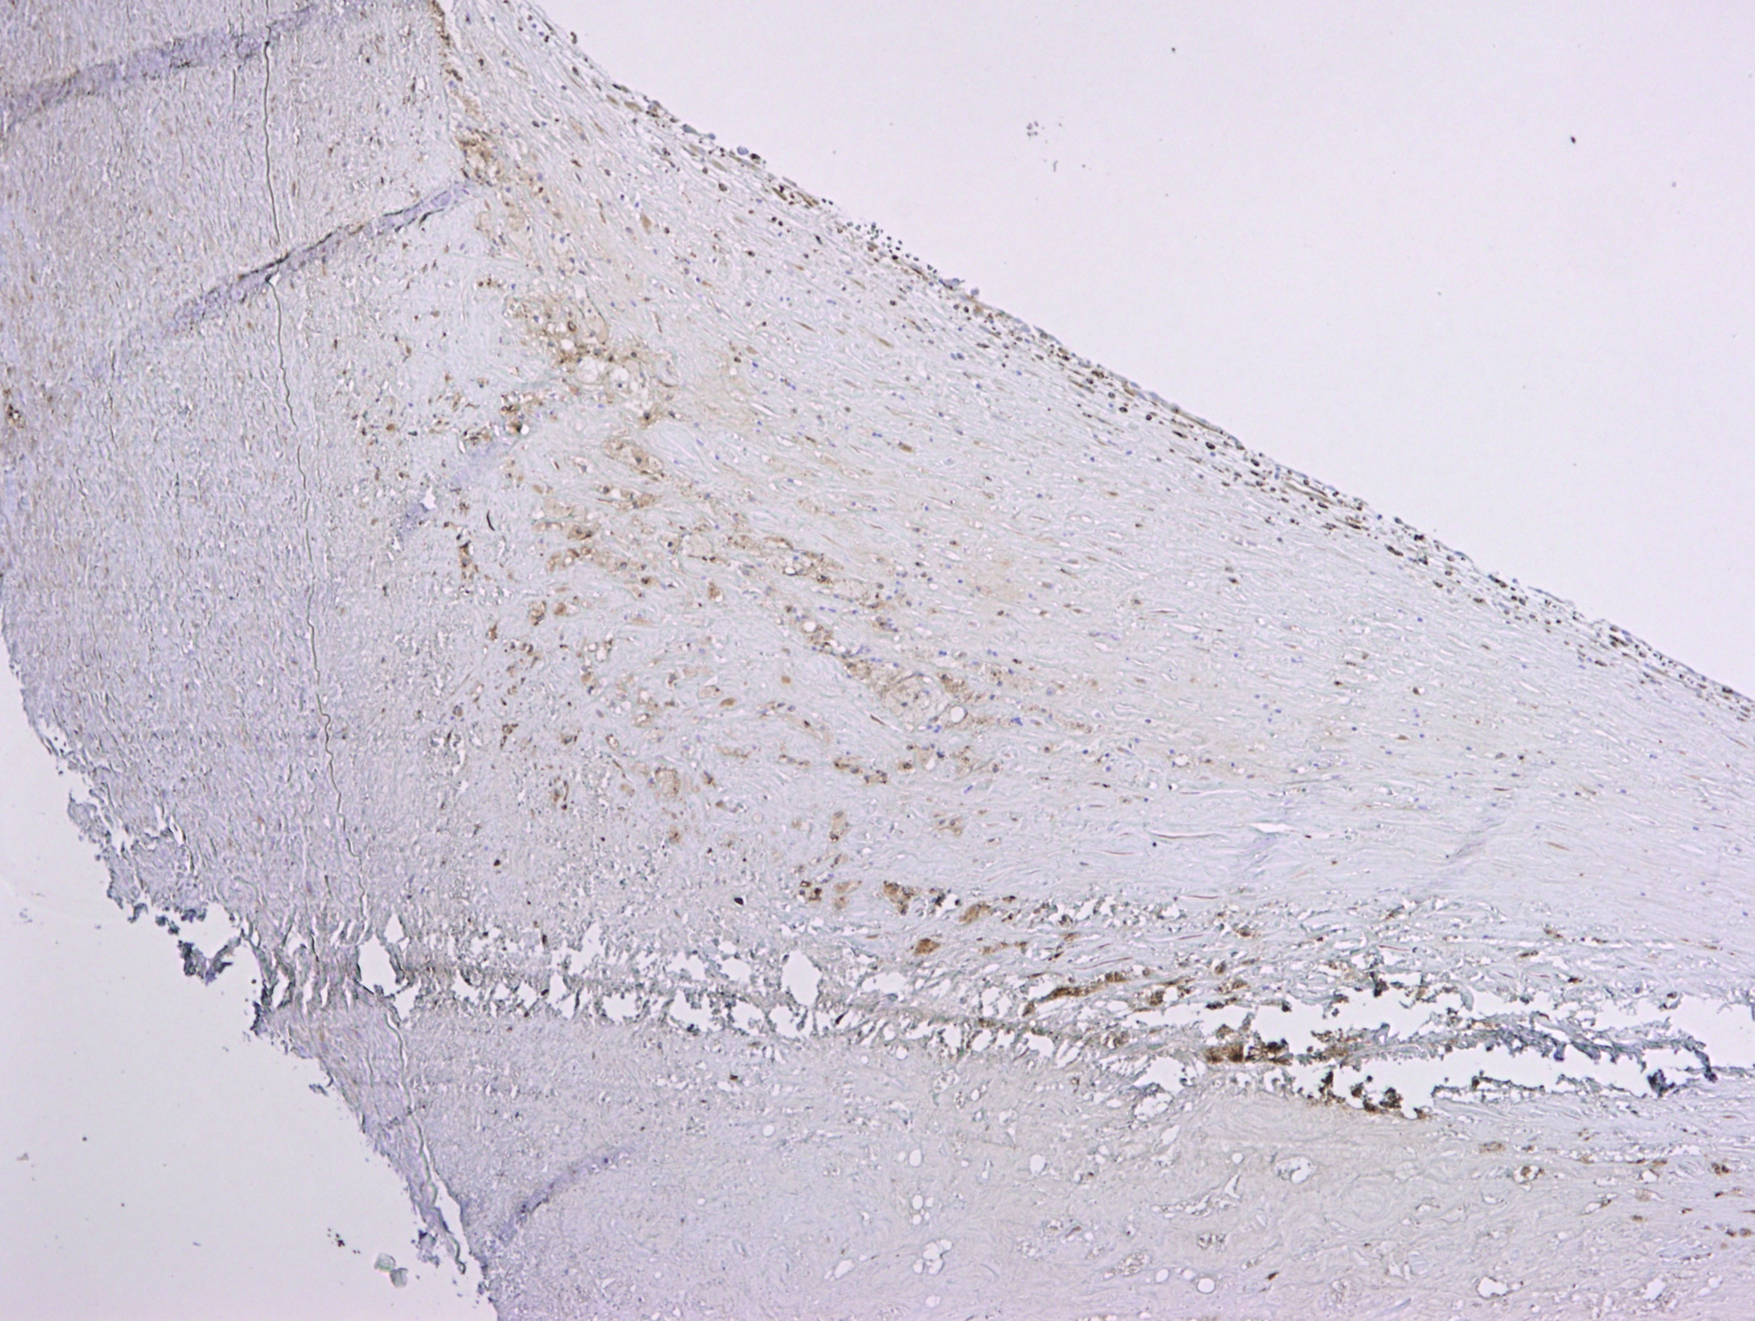
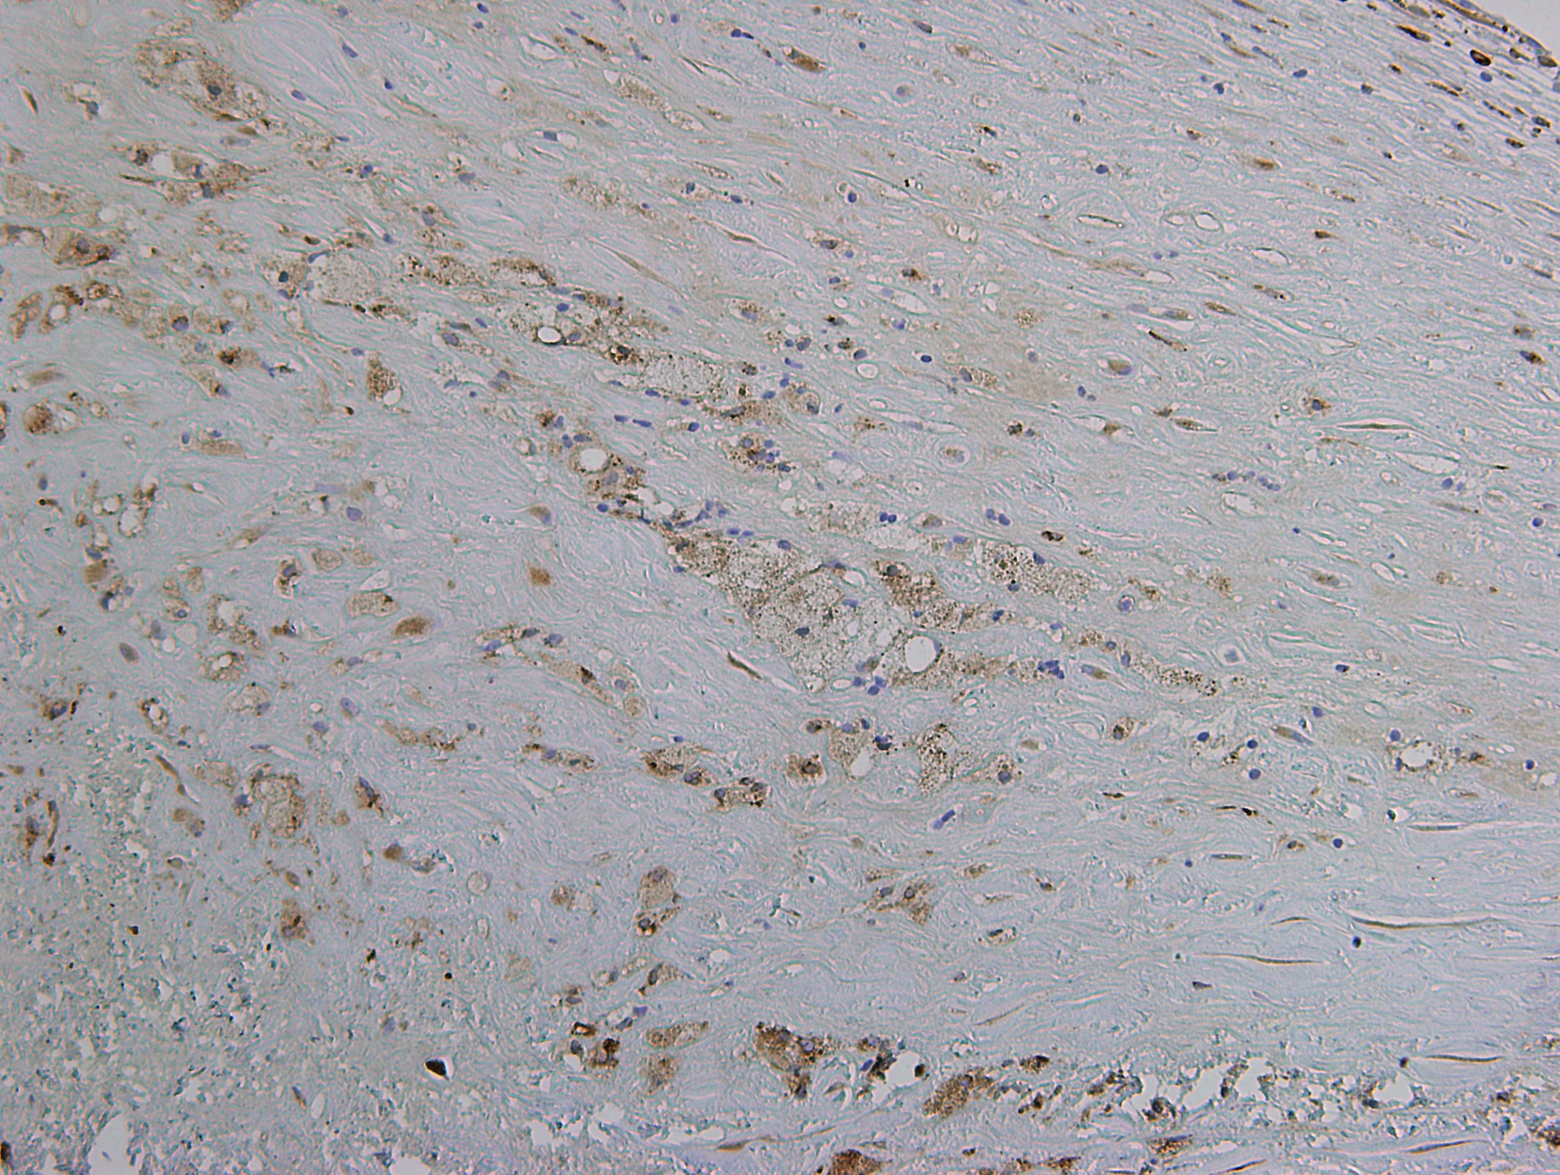
Carotid endarterectomy sample
Shoulder region, clear staining for CystC
Appears to be stronger in foamy cells, (foamy) smooth muscle cells
Van der Laan et al. unpublished

Slide 12
CystC in atherosclerosis
Van der Laan S.W. et al. JACC 2016

Slide 13
CystC as a biomarker for CKD
One of the best naturally occurring biomarker for human estimated glomerular filtration rate (eGFR)
It is a better biomarker than creatinine when eGFR>90 (mL/min/1.73m³)
Fried et al. Kid Intern 2009; Inker et al. NEJM 2012
Notes:
Chronic kidney disease epidemiology collaboration formula/equation

Slide 14
Epidemiological evidence
In elderly without chronic kidney disease (CKD), CystC is prognostic of death, cardiovascular disease (CVD) and CKD
Asymptomatic carotid atherosclerosis patients, CystC prognostic for CVD
CystC associated with lesion size in acute stroke

Slide 15
Literature meta-analyzed
CystC is associated with a higher risk of CVD, stroke and mortality in high-risk populations
Lee et al. Circ CQO 2010

Slide 16
Clinical applications
2 observational studies and 5 clinical trials focused on
Biomarker for diagnosis and prognosis
Marker of efficacy (treatment)
At least one drug in development: “RO4905417/INCLACUMAB” to reduce damage during PCI (Roche)
Patents
Cavadis B.V.: exosome derived biomarker for adverse cardiovascular events (several patents [pending])
Biomarker for peripheral artery disease (2469279)
CystC as a “drug” for the treatment of atherosclerosis (WO/2001/030370)
Roche: selection of therapy in heart failure (WO/2014/086833)
Siemens: biomarker for pulmonary hypertension (WO/2014/052803)

Slide 17
Hypothesis…
There is an large body of evidence from human and murine experiments and specimens that CystC is involved in atherosclerosis
Epidemiological studies show that CystC is associated with increased risk CVD
Plaque CystC and the percentage of SMCs in plaques are correlated
Is CystC causal to cardiovascular disease?

Slide 18
Fulfilling assumptions
Cystatin C and Cardiovascular Disease

Slide 19
The concept
For example: systolic blood pressure, or kidney function
In this case: cystatin C
Independent of confounding factors
In this case: cardiovascular disease
Proportional to the G > R and R > H effects
Katan, MB. Lancet 1986

Slide 20
SNP selection
Fulfilling assumptions

Slide 21
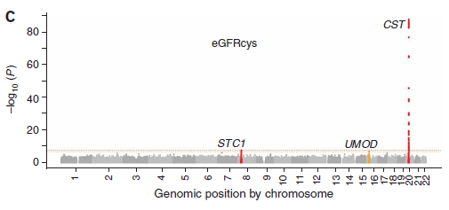
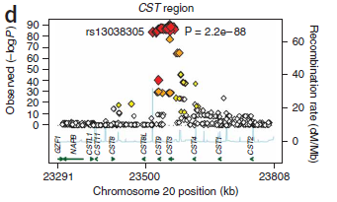
GWAS: locus with CST3 pops up (naturally)
4 subsequent Genome–Wide Association Study Meta-Analyses of eGFR and CKD revealed a region containing CST3 (Cystatin C) as significantly associated
Identification of three loci associated with eGFRcys aka CystC expression: STC1, UMOD, CST3
Köttgen et al. Nat Genet 2009
April 10, 2018 | 21

Slide 22
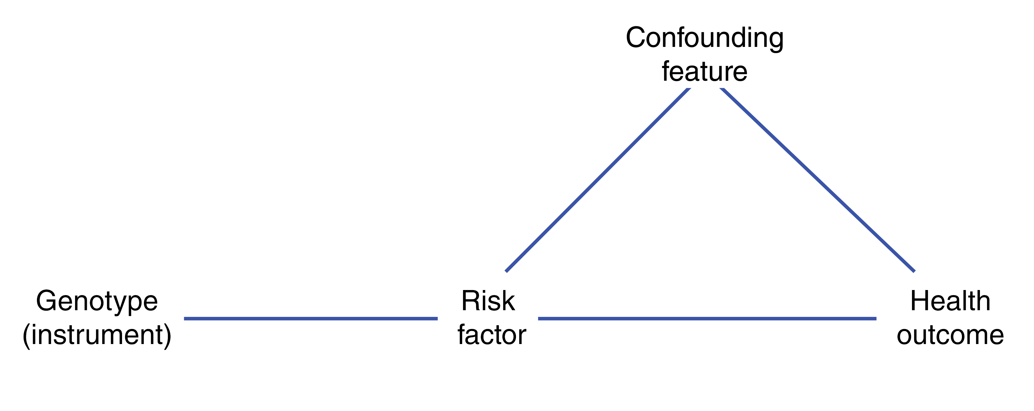
SNP selection
One GWAS on CystC, rs1158167 in Framingham Heart Study
Three (meta-analyses of) GWAS on eGFR_{CystC}
rs911119, rs13038305
eGFR_{CystC} = 76.7 x (serum CystC)^{-1.19}
Log linear relation between serum CystC and eGFR
Van der Laan S.W. et al. JACC 2016

Slide 23
SNP selection
Van der Laan S.W. et al. JACC 2016

Slide 24
SNP selection
Van der Laan S.W. et al. JACC 2016

Slide 25
Studies & Confounding
Fulfilling assumptions

Slide 26
Studies included
Van der Laan S.W. et al. JACC 2016

Slide 27
Serum cystatin C vs. risk factors
Van der Laan S.W. et al. JACC 2016

Slide 28
Cystatin C variant vs. risk factors
Van der Laan S.W. et al. JACC 2016

Slide 29
SNP vs. cystatin C
Per minor allele there is 6.13% decrease in CystC [mg/L]
β = -0.09 [-0.10 – -0.09], p = 5.95x10⁻¹⁶³ , N = 29,805
This explains ≈2.75% of the phenotypic variation
Van der Laan S.W. et al. JACC 2016

Slide 30
Observational analysis
Minimally adjusted model: age + sex
Van der Laan S.W. et al. JACC 2016

Slide 31
Observational analysis
Minimally adjusted model: age + sex
Fully adjusted model: age + sex + HDL + systolic blood pressure + BMI + smoking status + CKDEPI
Van der Laan S.W. et al. JACC 2016

Slide 32
Mendelian randomization analysis
Minimally adjusted model: age + sex
Fully adjusted model: age + sex + HDL + systolic blood pressure + BMI + smoking status + CKDEPI
Causal effect: nada, nothing, niets, rien, nichts, ничего
Interaction analysis: significant – models are different
Van der Laan S.W. et al. JACC 2016

Slide 33
Other outcomes
Van der Laan S.W. et al. JACC 2016

Slide 34
Power?
Fulfilling assumptions

Slide 35
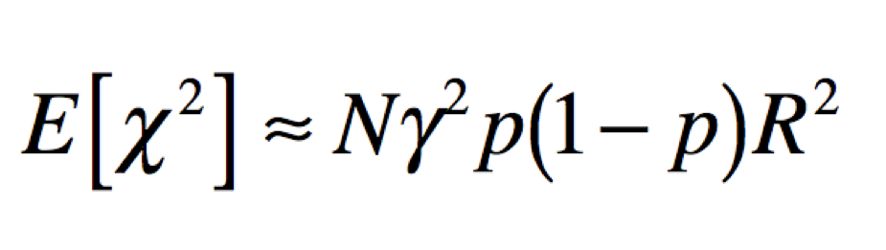
Power
Power to detect association
LD with causal variant
Effect size
Sample size
Allele frequency

Slide 36
The power problem

Slide 37
Did we have enough power?
Van der Laan S.W. et al. JACC 2016
https://github.com/swvanderlaan/publications

Slide 38
In summary
There is a correlation between the percentage of SMCs and CystC in plaques, and CystC levels appear to be lower in SMCs from AAAs
Strong epidemiological evidence exists for a role of CystC in CVD
Variants in CystC associated with serum CystC levels, eGFR_{CystC}
MR analysis: we find no evidence for a causal effect of CystC on CVD
Van der Laan S.W. et al. JACC 2016

Slide 39
Acknowledgements

Slide 40




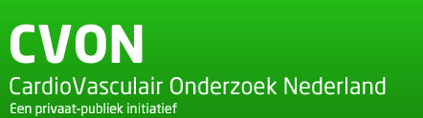
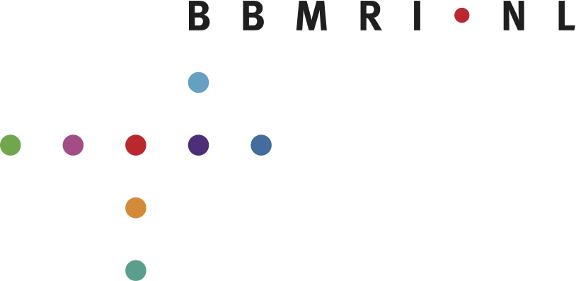






Acknowledgements
Financial support
ICIN (09.001), GENIUS (CVON2011-19), FP7 EU project CVgenes@target HEALTH-F2-2013-601456, BBMRI CP2013-63, Cavadis B.V.
Disclosure: this work is partly financed by Cavadis
www.cavadis.com

